Slide 1
The SCRUM AGILE Practice
Lee Kitchen
CS-250
SnHU

Slide 2

Agile Roles
Product Owner
Scrum Master
Development Team
The Product Owner represents the stakeholders and ensures that their needs are met.
Responsible for defining and prioritizing the product backlog based on business value.
Collaborates with the team to clarify requirements, answer questions, and provide feedback.
Importance: The Product Owner plays a crucial role in maintaining a clear vision, maximizing the value of the product, and keeping the team focused on delivering business outcomes.
The Scrum Master acts as a facilitator and coach for the team.
Removes impediments and ensures a smooth workflow.
Organizes Scrum events (such as sprint planning, daily stand-ups, sprint reviews, and retrospectives) to promote collaboration and continuous improvement.
Importance: The Scrum Master supports the team in following Scrum principles, maintains an environment conducive to productivity, and helps the team self-organize and achieve their goals.
The Development Team consists of professionals responsible for delivering the product increment.
Collaboratively estimates effort, selects and commits to user stories in each sprint.
Designs, develops, tests, and delivers high-quality increments.
Importance: The Development Team's expertise and collective effort drive the successful completion of user stories, ensuring the product meets the Definition of Done and delivers value to stakeholders.

Slide 3

Agile Roles
Stakeholders
Stakeholders are individuals or groups with an interest or influence in the product.
Actively engage with the team and provide feedback on the product increment.
Collaborate with the Product Owner to prioritize and refine the product backlog.
Importance: Stakeholders provide valuable insights, validate product direction, and contribute to the iterative development process, ensuring the product meets their needs and expectations.

Slide 4

Phases of the SDLC
Agile methodologies bring flexibility and adaptability to the traditional SDLC.
Requirements Gathering
In Agile, requirements gathering is an ongoing process throughout the project.
Initial requirements are captured as user stories or product backlog items.
Collaborative discussions with stakeholders refine and prioritize requirements.
Importance: Continuous requirements gathering ensures the development team stays aligned with business needs and can adapt to evolving requirements.

Slide 5

Phases of the SDLC
Design and Planning
Design and planning activities are iterative in Agile.
High-level design is performed initially, followed by detailed design in each iteration.
Planning sessions involve breaking down requirements into manageable units of work (user stories).
Importance: Iterative design and planning facilitate flexibility, allow for continuous feedback, and enable the team to adapt to changing needs.

Slide 6

Phases of the SDLC
Development and Testing
Development and testing activities occur concurrently throughout the project.
Development follows the prioritized user stories, focusing on delivering small increments.
Test-driven development (TDD) or behavior-driven development (BDD) may be utilized.
Importance: Continuous development and testing promote early feedback, identify issues sooner, and ensure higher-quality deliverables.

Slide 7

Phases of the SDLC
Deployment and Delivery
In Agile, deployment and delivery are frequent and incremental.
Working increments are released to stakeholders regularly (e.g., at the end of each sprint).
Continuous integration and continuous deployment practices streamline the release process.
Importance: Frequent deployment and delivery allow stakeholders to provide feedback early, validate functionality, and realize business value sooner.

Slide 8
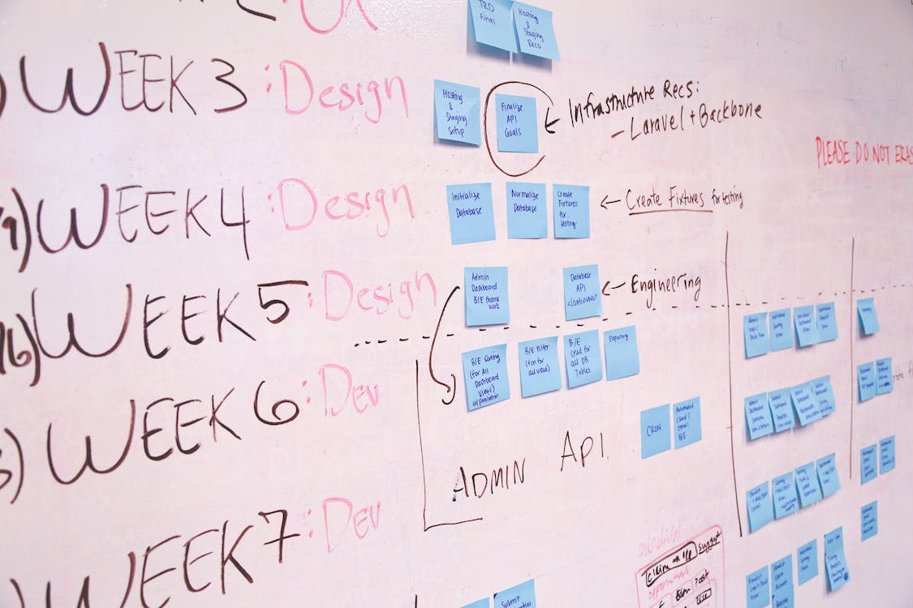
Agile vs Waterfall
Agile Approach
Discovery: The defect is identified during testing.
Prioritization: The Scrum Master and the Product Owner collaborate to assess the severity and impact of the defect.
Adaptation: The Development Team immediately addresses the defect, either by fixing it within the current sprint or creating a new user story for the next sprint.
Testing and Validation: Once fixed, the defect is thoroughly tested to ensure the resolution is effective.
Deployment: The fixed increment is deployed, and stakeholders provide feedback.

Slide 9
Agile vs Waterfall
Waterfall Approach
Discovery: The defect is identified during testing.
Documentation: The defect is documented, including its details, impact, and steps to reproduce.
Change Request: A change request is submitted to initiate the process of fixing the defect.
Analysis: The change request undergoes analysis to determine the feasibility, estimated effort, and potential impact on the project timeline.
Approval: The change request is reviewed and approved by stakeholders.
Development: The development team works on fixing the defect based on the approved change request.
Testing: After the defect is fixed, dedicated testing is performed to verify the resolution.
Regression Testing: Regression testing is conducted to ensure the fix did not introduce any new issues.
Documentation: The defect resolution process and results are documented.
Deployment: The fixed increment, including the defect resolution, is deployed.
Validation: Stakeholders validate the fixed increment to ensure the defect is resolved successfully.

Slide 10

Agile vs Waterfall
Key Differences and Implications:
Time and Effort: In the waterfall approach, the process of documenting, analyzing, and approving the change request consumes additional time and effort before the development team can address the defect.
Lack of Flexibility: The waterfall approach follows a rigid sequence of phases, making it challenging to accommodate changes quickly. The fix for the defect may not be implemented until a later stage in the project.
Limited Stakeholder Involvement: Stakeholders' involvement is mostly limited to the approval stage, reducing their ability to provide immediate feedback on the resolution.
Delayed Deployment: The defect resolution may take longer to reach stakeholders since it follows a linear progression, potentially delaying the delivery of the fixed increment.

Slide 11
Waterfall Or Agile Approach?
Project Requirements and Predictability
Project Size and Complexity
Waterfall: Well-defined and stable requirements
Course project example with clear initial requirements and minimal changes
Agile: Changing requirements, frequent updates, or innovation
Course project involving a mobile application with evolving user needs
Waterfall: Large-scale projects with complex dependencies and extensive planning needs
Course project with a complex database management system
Agile: Smaller and less complex projects
Course project building a simple web application

Slide 12
Waterfall Or Agile Approach?
Stakeholder Involvement and Collaboration
Team Experience and Expertise
Waterfall: Limited stakeholder availability or hands-off approach
Course projects where stakeholders had minimal involvement or preferred final product review
Agile: Active involvement, continuous collaboration, and influence
Course project with ongoing stakeholder feedback and regular demos
Waterfall: Experienced team familiar with waterfall approach
Course project where team members had prior successful waterfall execution
Agile: Experience or willingness to adapt to agile methodologies
Course project with team members experienced in agile principles

Slide 13

Conclusion
Consider project requirements, predictability, size, complexity, stakeholder involvement, and team experience.
Choose the methodology that best aligns with project characteristics.
Maximizes the chances of success and effective project execution.

Slide 14
References
Charles G. Cobb. (2015). The Project Manager’s Guide to Mastering Agile : Principles and Practices for an Adaptive Approach. Wiley.
All Photos sourced from pexels.com with free use attribution is not required per license.

